Slide 1
Python
Image

Slide 2
Hue Histogram Feature Extractor
Edge Histogram Feature Extractor,
HAAR like Feature Extractor using Classifiers for Image Classification.
Identifying Emotions of People Found in a Image ,
Identifying Landmarks within Image, Face Recognition ,
Text Extraction from Image of a Cheque-OCR,
Label Detection based on Google Knowledge Graph

Slide 3
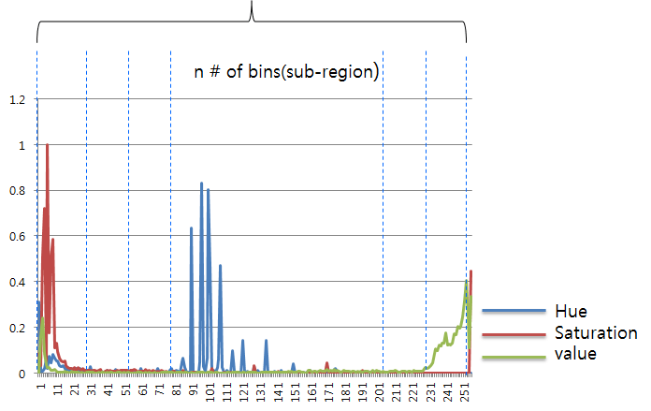
Hue Histogram Feature Extractor

Slide 4
In applications like face recognition which a vector (or a matrix) is extracted from the whole sample image
• In applications like image (pixel) classification which a vector (or a matrix) is extracted for each pixel in the sample image:

Slide 5
Computer Vision
A histogram represents the distribution of colors in an image. It can be visualized as a graph (or plot) that gives a high-level intuition of the intensity (pixel value) distribution. We are going to assume a RGB color space in this example, so these pixel values will be in the range of 0 to 255.

Slide 6
We will be using the cv2.calcHist function in OpenCV to build our histograms. Before we get into any code examples, let’s quickly review the function:
cv2.calcHist(images, channels, mask, histSize, ranges)
images: This is the image that we want to compute a histogram for. Wrap it as a list: [myImage].
channels: A list of indexes, where we specify the index of the channel we want to compute a histogram for. To compute a histogram of a grayscale image, the list would be [0]. To compute a histogram for all three red, green, and blue channels, the channels list would be [0, 1, 2].
mask: I haven’t covered masking yet in this blog yet, but essentially, a mask is auint8 image with the same shape as our original image, where pixels with a value of zero are ignored and pixels with a value greater than zero are included in the histogram computation. Using masks allow us to only compute a histogram for a particular region of an image. For now, we’ll just use a value of None for the mask.
histSize: This is the number of bins we want to use when computing a histogram. Again, this is a list, one for each channel we are computing a histogram for. The bin sizes do not all have to be the same. Here is an example of 32 bins for each channel: [32, 32, 32].
ranges: The range of possible pixel values. Normally, this is [0, 256] for each channel, but if you are using a color space other than RGB (such as HSV), the ranges might be different.

Slide 7
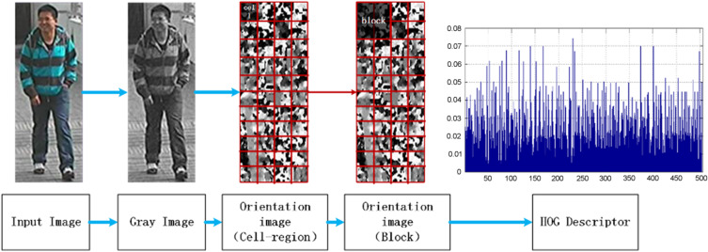

Slide 8
# Edge Histogram Feature Extractor
# MPEG 7 provides a fairly well defined (and well thought out)
# edge histogram descriptor [EHD] which essentially serves your purpose.

Slide 9
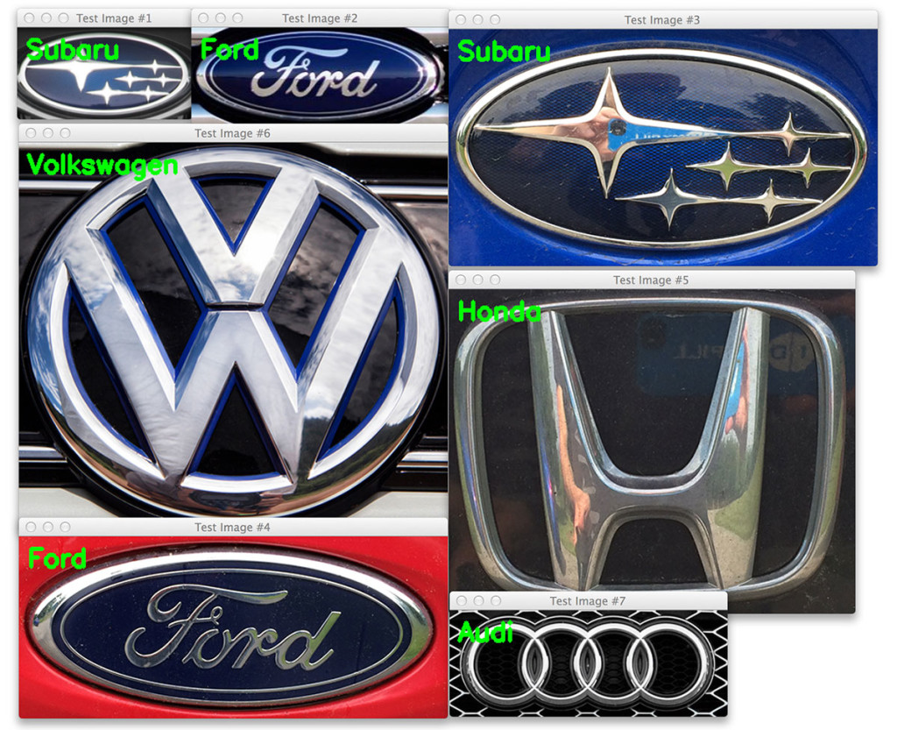

Slide 10
Normalizing the image prior to description.
Computing gradients in both the x and y directions.
Obtaining weighted votes in spatial and orientation cells.
Contrast normalizing overlapping spatial cells.
Collecting all Histograms of Oriented gradients to form the final feature vector.

Slide 11
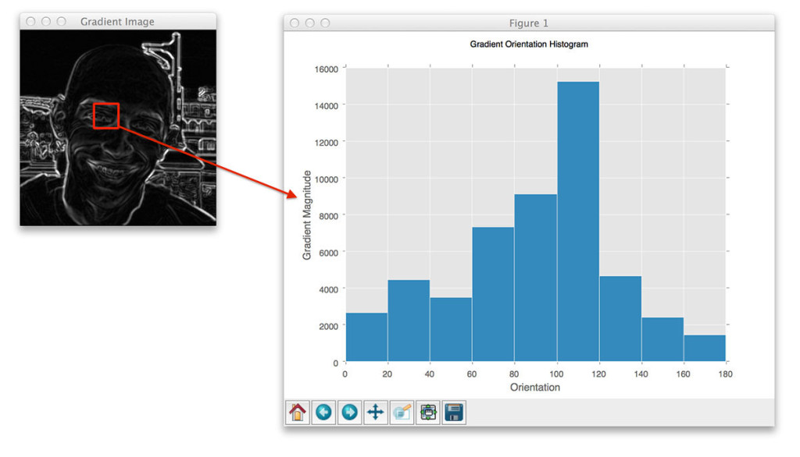
Histogram of Oriented Gradients

Slide 12
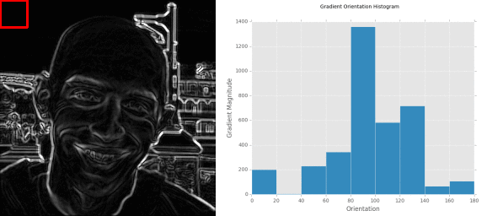

Slide 13
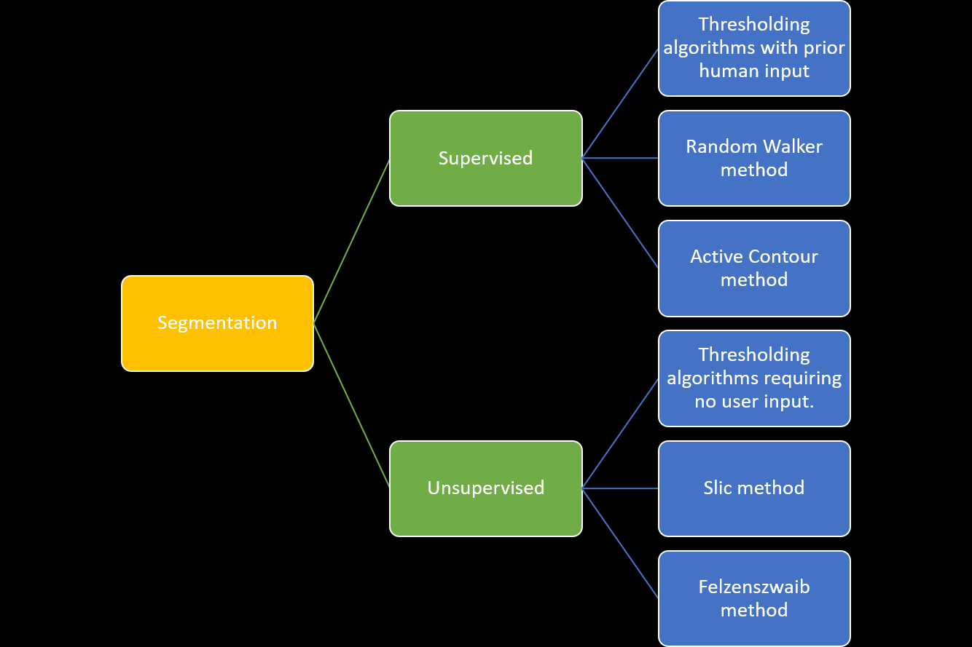

Slide 14
Haar-like features are digital image features used in object recognition. They owe their name to their intuitive similarity with Haar wavelets and were used in the first real-time face detector.
OpenCV already contains many pre-trained classifiers for face, eyes, smile etc. Those XML files are stored in opencv/data/haarcascades/ folder. Let’s create face and eye detector with OpenCV.

Slide 16
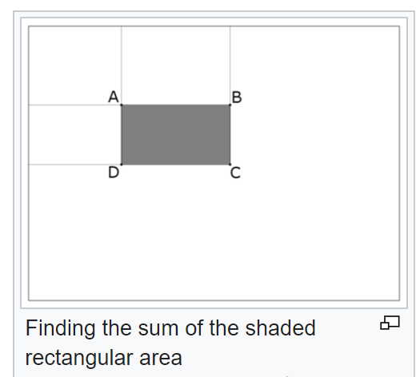

Slide 17

A Face Database containing emotions (the Cohn-Kanade database).

Slide 18
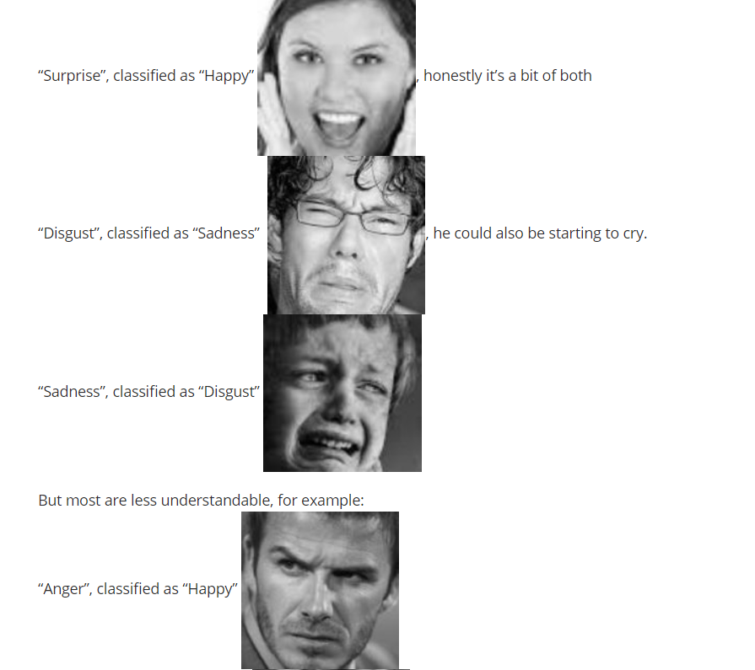

Slide 19
Emotional
0=neutral, 1=anger, 2=contempt, 3=disgust, 4=fear, 5=happy, 6=sadness, 7=surprise.

Slide 20
Text Extraction
Label Detection based on Google Knowledge Graph

Slide 21

Image - Label

Slide 22
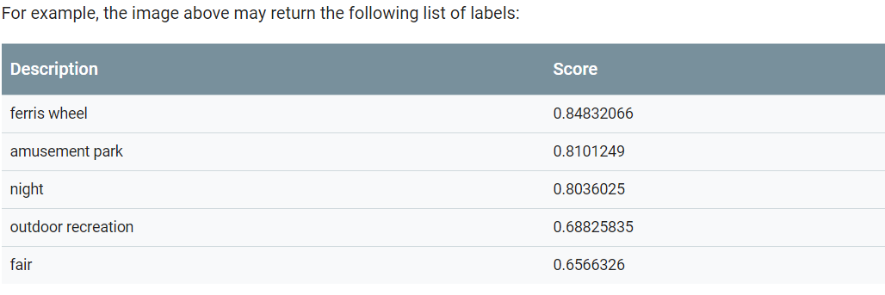

Slide 23
What are Knowledge Graphs?
Chances are that if you’re reading this for SEO purposes, you inevitably already know what knowledge graphs are. As such, I’ll refrain from spending too much time going into detail on that subject. In essence, knowledge graphs are the panels seen on the right side of search results for a myriad of entity types. These “types” can vary from people, places, music, scientific theories, art etc. Depending on this type, knowledge graphs provide the user with information about the subject. If the knowledge graph is for a corporation, there is typically information on the current CEO, headquarters, year founded etc.

